Slide 1
Bundle of Sticks
Mrs. Amanda

Slide 2
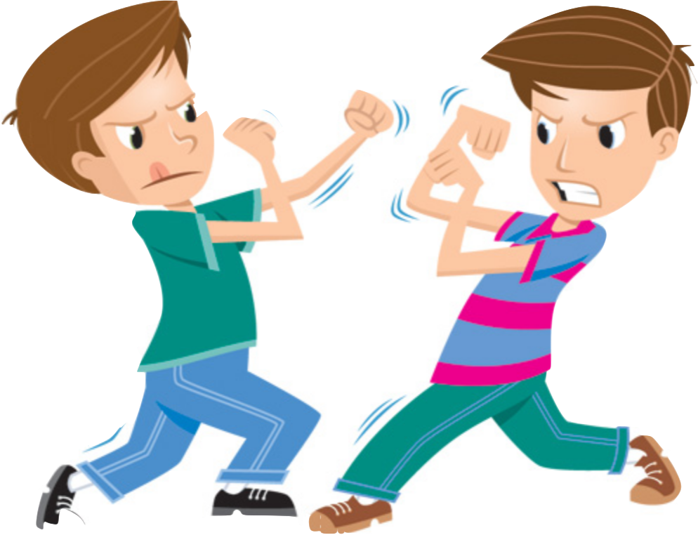
Bundle of Sticks

Slide 3
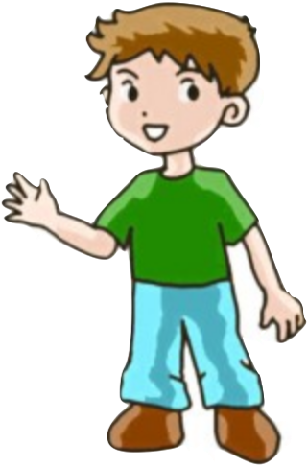
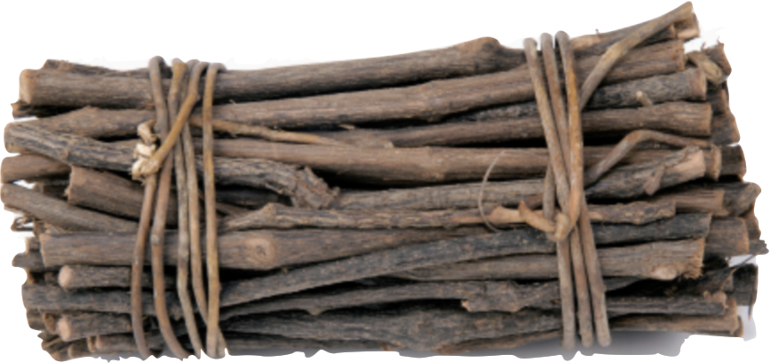
Bundle of Sticks

Slide 4
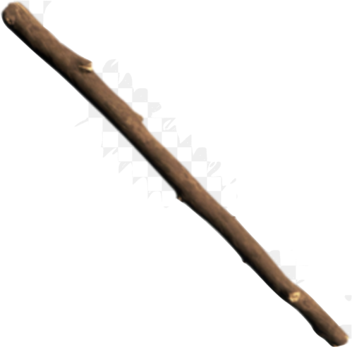
Bundle of Sticks

Slide 5
Moral
There is unity in strength.
It is better to work together.
We are stronger together.

